Slide 1
Smart Job Match AI — End-to-End Automation System
23071A05T0 - Sai Krishik

Slide 2
01
Introduction

Slide 3
Introduction
Smart Job Match AI is a modern AI-powered system that bridges the gap between job seekers and recruiters through intelligent automation. It parses resumes, scrapes fresh job listings, and matches candidates to best-fit roles using smart algorithms. The system offers faster applications, higher job relevance, and reduced manual effort, while seamlessly integrating with existing job platforms, Gmail, and LinkedIn to deliver personalized job recommendations directly to users. By combining AI reasoning and workflow automation, Smart Job Match AI makes recruitment smarter, faster, and more efficient for everyone, while also continuously learning from user interactions to improve job matching accuracy over time.

Slide 4
02
Purpose and Overview

Slide 5
Purpose and Overview
Goal: Automate the entire process of resume parsing, job scraping, and AI-based job matching to reduce manual effort and improve efficiency.
How it works: Users upload their resume → the system extracts key profile details → scrapes the latest job listings → performs AI-based matching based on skills and experience → delivers the top personalized job results directly to the user.
Tools used:
n8n – Workflow automation
Lovable AI – Intelligent reasoning and user interaction
Google Sheets – Data storage and tracking
Gmail – Automated email delivery
Gemini AI – Advanced natural language processing and job reasoning
Value proposition: Eliminates time-consuming manual matching, accelerates job recommendations, and ensures higher-quality matches through intelligent, data-driven automation.

Slide 6
03
System Architecture

Slide 7
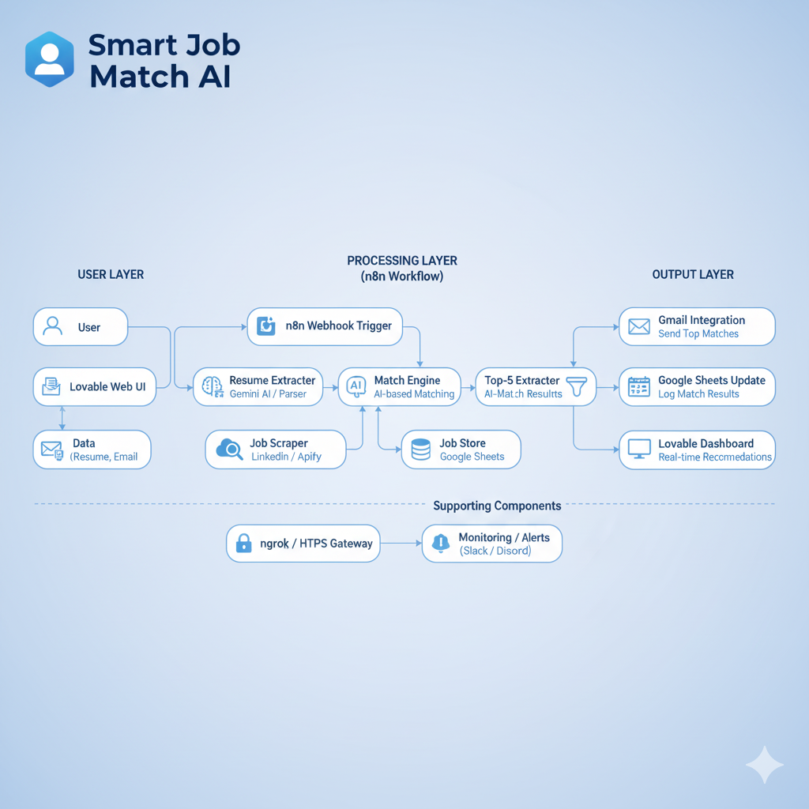
System Architecture

Slide 8
04
Key Components

Slide 9
Key Components
n8n Workflow: Orchestrates triggers, parsing, scraping, matching, and notifications through a visual automation platform
Lovable AI Agent: Hosts user-facing dashboard and actions, providing an intuitive interface for job seekers
Google Sheets: Central, searchable job dataset that maintains all scraped job listings and their details
LinkedIn Scraper / Apify: Collects fresh job postings from multiple sources to ensure up-to-date opportunities
Gmail Integration: Sends matched job summaries to users with personalized recommendations and direct links

Slide 10
Workflow Snapshots
05

Slide 11
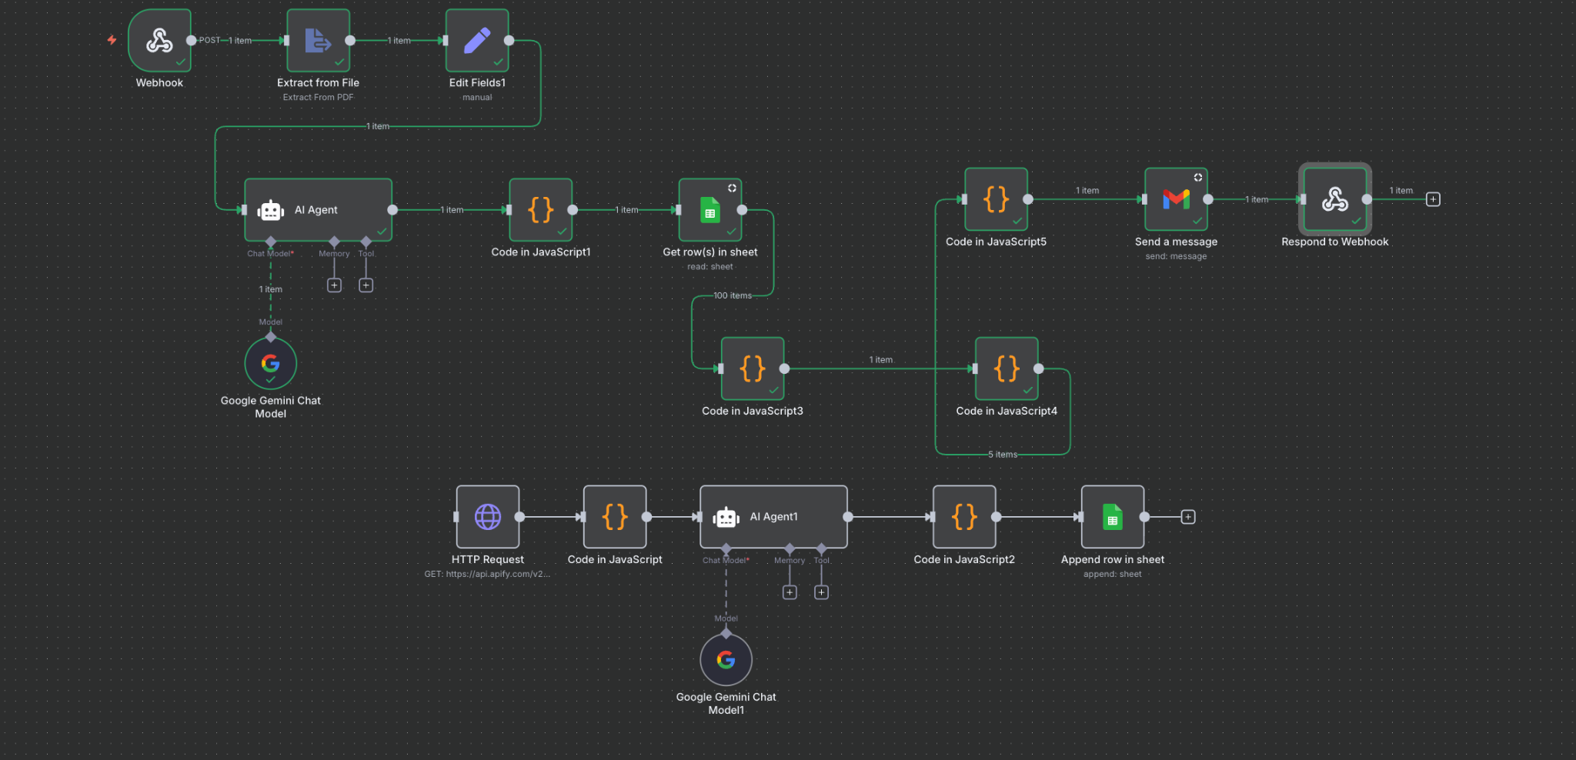

Slide 12
06
Output And Notifications

Slide 13
Output And Notifications
Gmail: Branded email with Top-5 matches, scores, and apply links delivered directly to candidate's inbox
Google Sheets: Saved results including job ID, title, company, match score, application link, and timestamp for tracking
Lovable Dashboard: Real-time view of matches with filtering options and application status tracking
All outputs maintain consistent data format and branding elements for seamless user experience

Slide 14
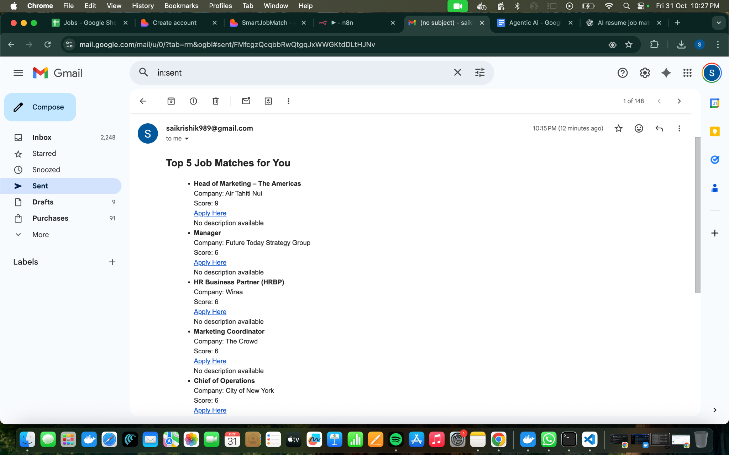

Slide 15
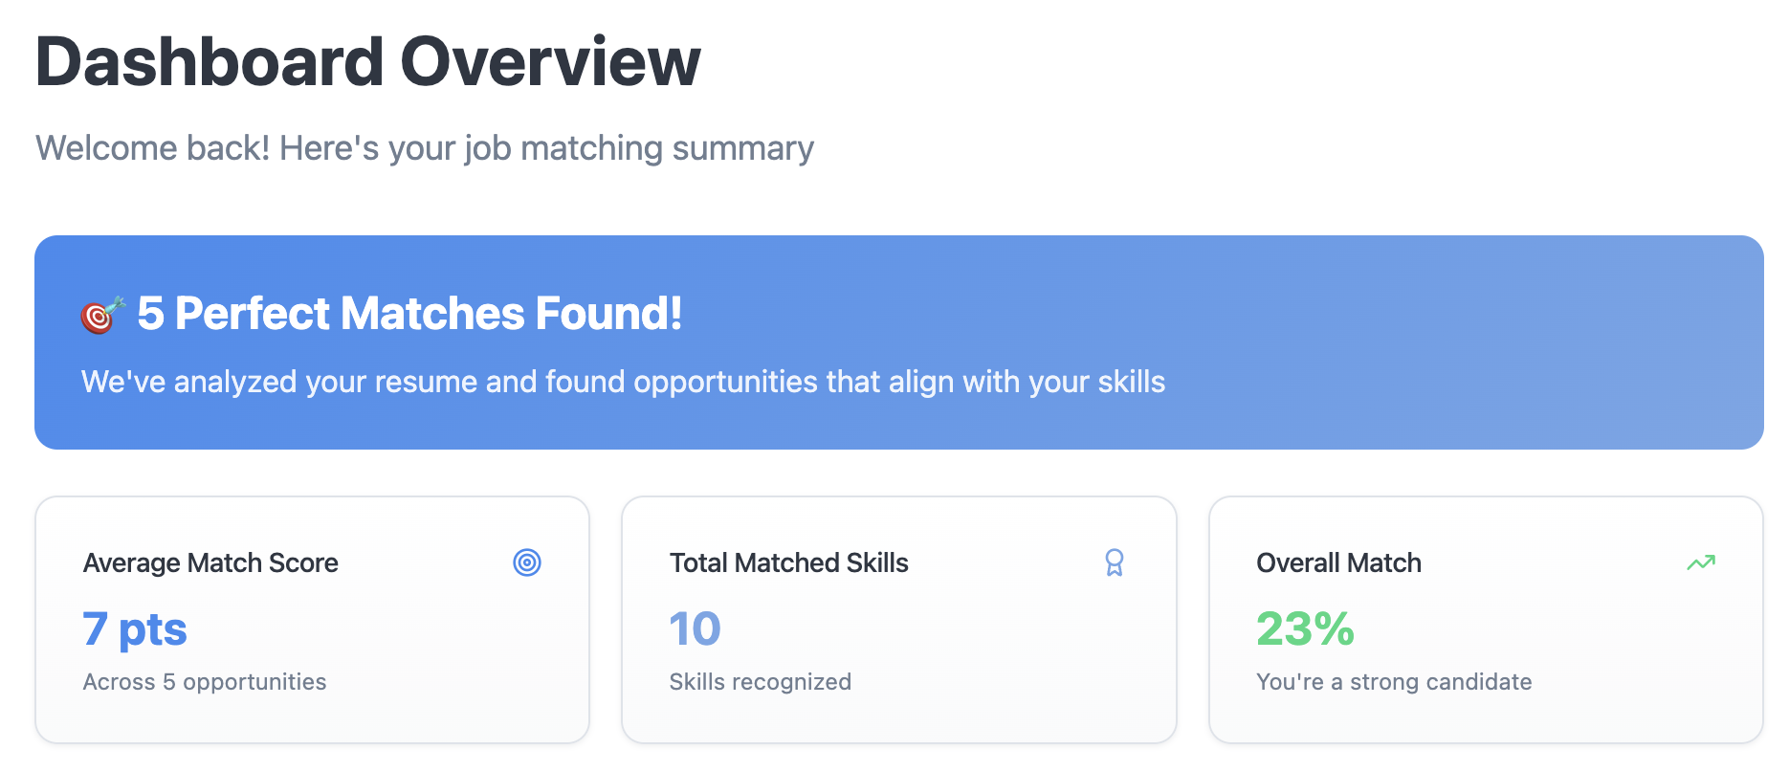
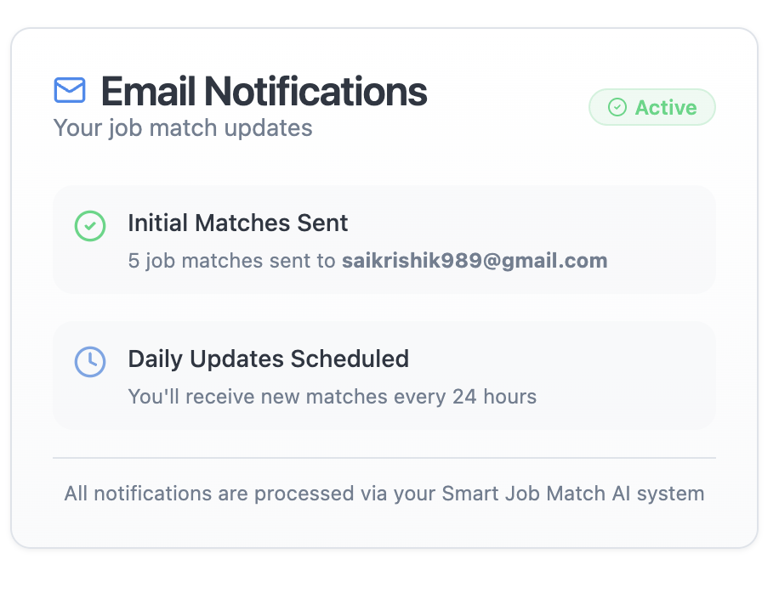
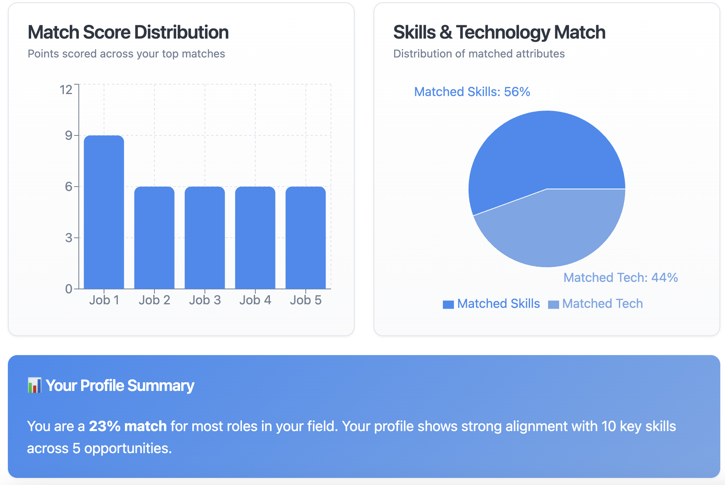

Slide 16
07
Conclusion and Future Scope

Slide 17
Conclusion and Future Scope
Impact: Faster job sourcing, higher match quality, and significantly reduced manual workload for both job seekers and recruiters
Value: Seamless bridge between candidates and opportunities through intelligent automation and AI matching
Future improvements: Real-time job scraping, personalized recommendations based on career preferences
Expansion opportunities: Feedback loops for continuous learning, multi-language support, and direct ATS integrations

Slide 18
Thank You!

